Slide 1
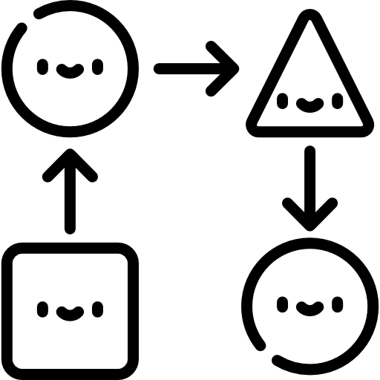
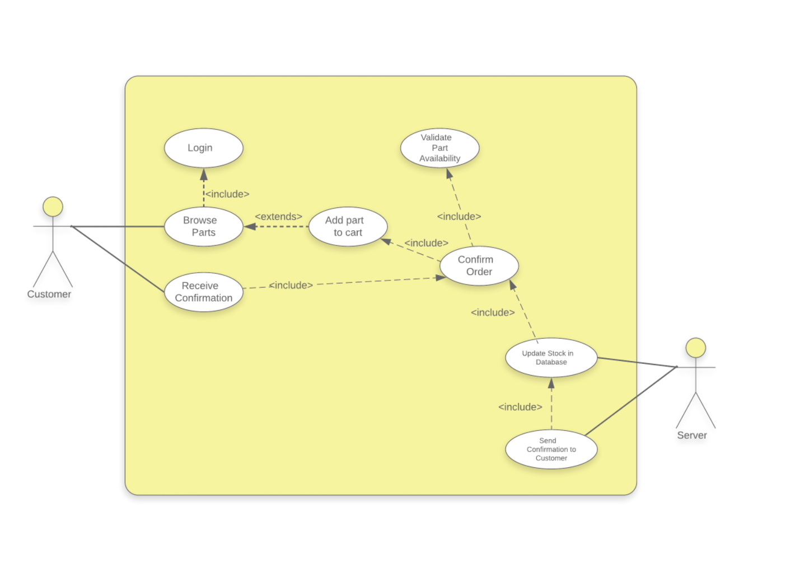
USE CASE DIAGRAM
VPOOS

Slide 2

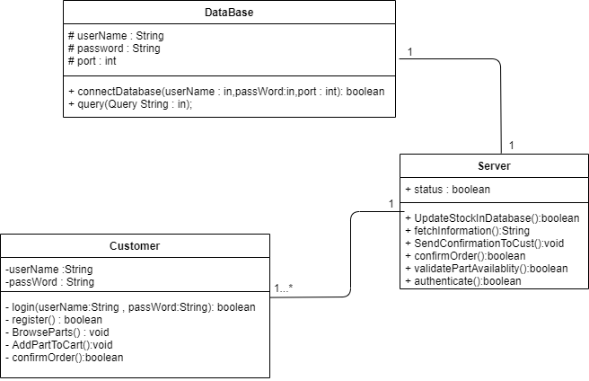
CLASS DIAGRAM

Slide 3

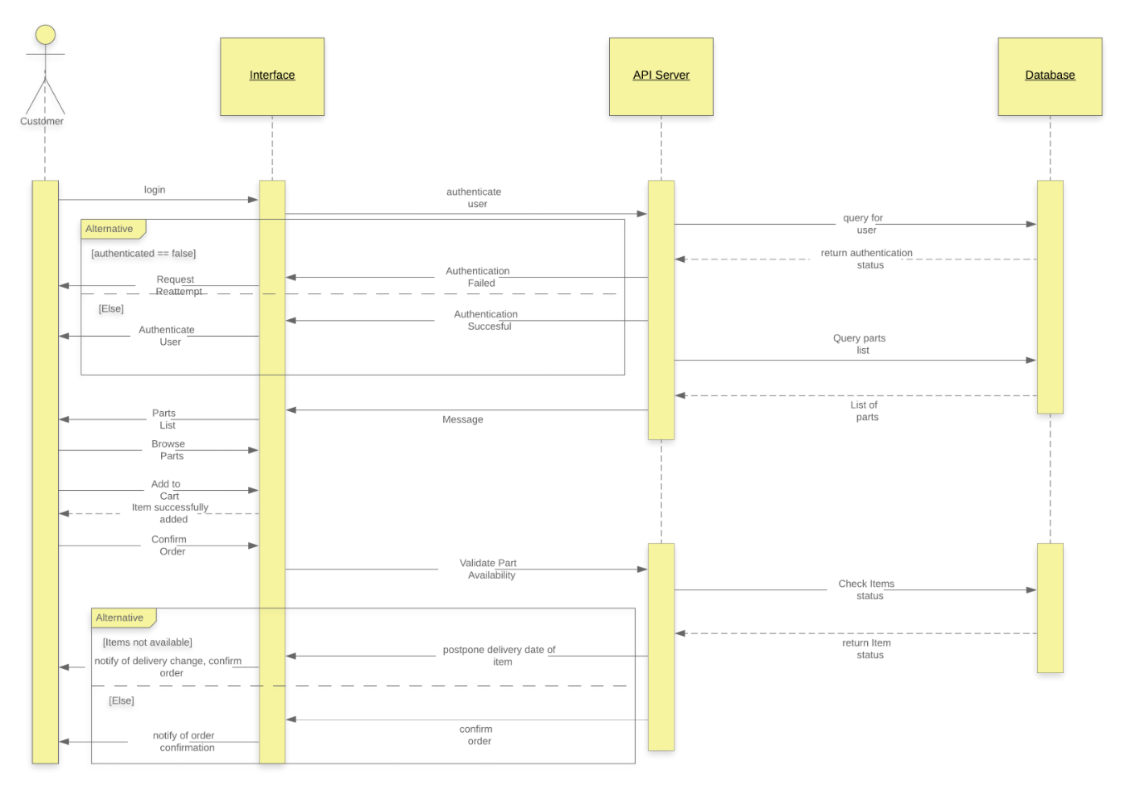
SEQUENCE DIAGRAM

